Slide 1
2-Bit Gray Code Up/Down Counter
In this type of counter, there is an input that dictates whether the counter increments or decrements.
This counter can still be implemented as a Moore machine and use state-encoded outputs.

Slide 2
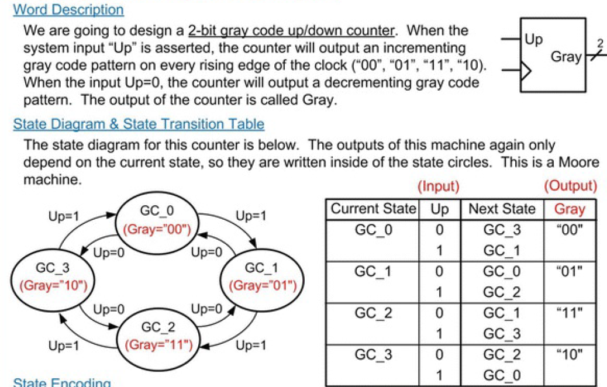
2-Bit Gray Code Up/Down Counter

Slide 3
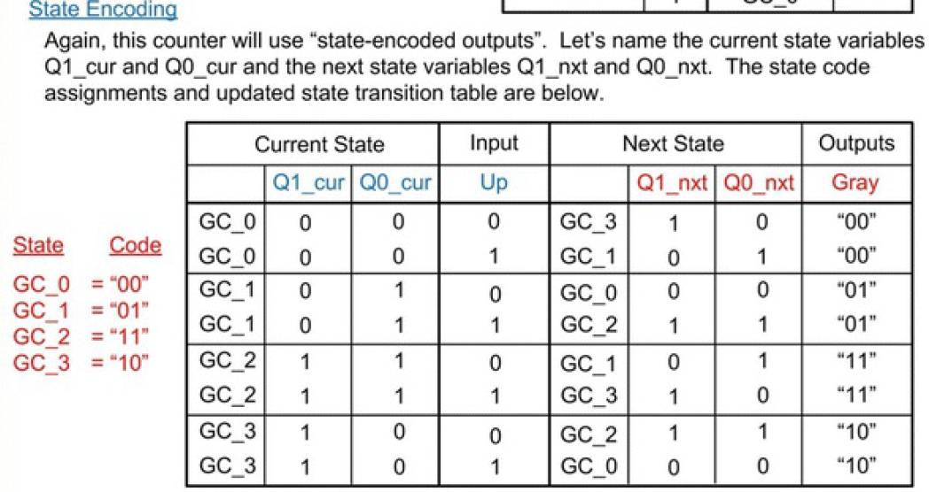
2-Bit Gray Code Up/Down Counter

Slide 4
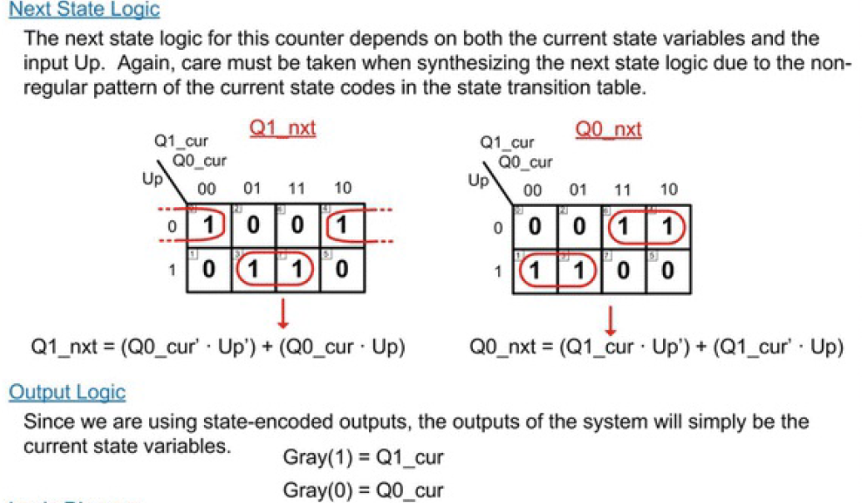

Slide 5
